Slide 1
CS686 Data Mining EEG Brainwave for Confusion
Min Chen Thanawut Ananpiriyakul Shiyi Tan
Notes:
Start presentation with Min.

Slide 2
Agenda
Experiment & Dataset
Tools and Frameworks
Problem Description
Data Preprocessing
Models and Evaluation
Challenges

Slide 3
Experiment & Dataset
EEG: An electrophysiological monitoring method to record electrical activity of the brain.
EEG data were collected from 10 college students watching at 10 videos.
Each video can be confusing or not confusing. Students rated them during the experiment.
1-channel wireless headset was used to record brainwave.
We have 12811 rows and 15 columns.
The data was aggregated. 1 row means 0.5 second.

Slide 4
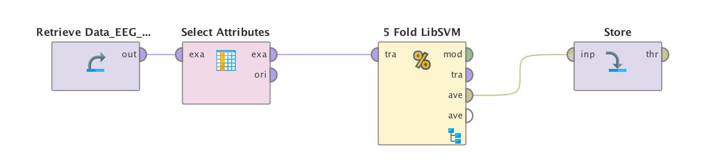
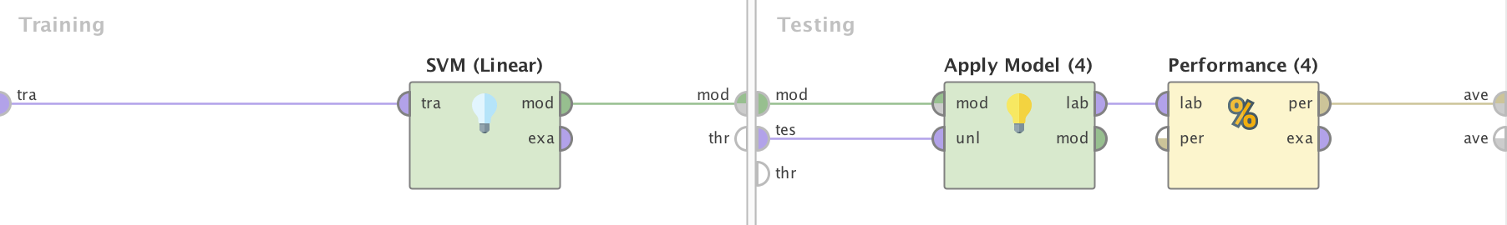
Tools & Frameworks
Rapidminer (Good for Exploratory Analysis)
Powerful & Easy to Use
Drag & Drop (with a little coding)
Visualize data and Get Threshold of Models’ Accuracy
R Programming Language
Powerful & Flexible
Need Coding
Take Time to Develop

Slide 5
Problem Description
We want to predict confusion of lecture videos from EEG data.
Problem Type: Binary Classification
Target: Confusing (Yes / No)
Features:
Attention
Meditation
Raw
Delta
Theta
Alpha1
Alpha2
Beta1
Beta2
Gamma1
Gamma2
Subject ID
Video ID

Slide 6
Data Preprocessing
Feature Selection
Normalization
Feature Generation
Data Aggregation
Notes:
Jump starts here.

Slide 7
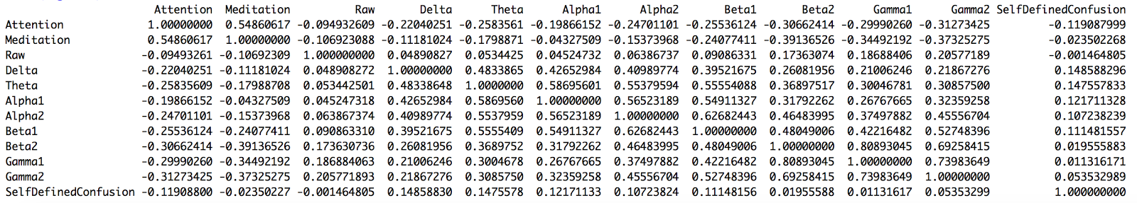
Feature Selection
No strong relationship has been found between each feature and target.
The highest correlation is 0.15 and the lowest correlation is -0.12.

Slide 8
Feature Selection
We only have 13 features.
Only Subject ID and Video ID have been removed.
Removing more features does not help increase the accuracy.
Attention
Meditation
Raw
Delta
Theta
Alpha1
Alpha2
Beta1
Beta2
Gamma1
Gamma2
Subject ID
Video ID

Slide 9
Normalization
Each feature has different range.
Range can be in 100 or up to a few 10000s.
Use “preProcess” function from “caret” package.
Method “range” will scale data into range [0,1].
Plot of Delta before Normalization
Plot of Delta after Normalization

Slide 10
Feature Generation
Since our data are time series.
Differences of data in each row are added as features.
Now we have 22 features.
Attention | ΔAttention | Meditation | ΔMeditation | Raw | ΔRaw
0.68 |  | 0.5 |  | 0.8
0.61 | -0.07 | 0.52 | +0.02 | 0.67 | -0.13
0.63 | +0.02 | 0.51 | -0.01 | 0.72 | +0.05

Slide 11
Data Aggregation
Aggregate data from 0.5 second to 5 seconds.
This method will help smoothen the data.
Our goal is to predict confusion of a video (2 mins) not just a data point (0.5 second).
Plot of Delta before Aggregation
Plot of Delta after Aggregation
Notes:
Cici starts here.

Slide 12
Model and Evaluation
Selected Models
K-Nearest Neighbors
Logistic Regression
Linear Discriminant Analysis
Quadratic Discriminant Analysis
Decision Tree
Random Forests
Boosting
Support Vector Machines
Neural Network
We have 10 subjects and 10 videos.
We have 100 cases in total.
We do Leave-One-Out Cross Validation.

Slide 13
Accuracy

Slide 14
Challenges
The data is only one channel.
1-channel wireless headset was used in the experiment.
The data is very noisy.
The electrode was placed at the skin.

